Slide 1
Effective teamwork in end-of-life care
End-of-Life Essentials (EOLE) is a National Palliative Care Project funded by the Australian Government Department of Health and Aged Care and delivered by Flinders University.

Slide 2
Aims and objectives
To develop an understanding of the importance of teamwork in end-of-life care.
After completing this talk, you should be able to:
Analyse the factors that may influence effective teamwork
Begin to identify your own capabilities in building psychological safety
Identify tools to assist in managing conflict
Identify which End-of-Life Essentials module to complete next.

Slide 3
Who is on the patient’s healthcare team?
Think of the health care provided to an older patient. So many providers contributing including:
the general practitioner
the orthopaedic team (or cardiology or oncology or respiratory……)
the nurses on the ward
the allied health practitioners (e.g., physiotherapy, dietitian, social worker)
the pharmacist
together with the patient and their family.
Patients and families are part of the team. But they are often excluded from decision-making.

Slide 4
Key factors for effective teamwork
Key factors for effective teamwork in end-of-life care include:^{1,2}
Leadership – champions who can drive change in hospitals, services and units. Are you this person?
Cultural readiness to allow patients to steer and be centre of care -
Allowing patients and families into a team means making room for them and listening to and respecting their requests.
A clear vision of patient goals of care -
Not only negotiating with the patient (and their family) but communicating goals of care to the wider team, the GP, and others.

Slide 5
Key factors for effective teamwork
Key factors for effective teamwork in end-of-life care include:^{1,2}
Clarity regarding roles of all team members -
Are your strengths around spiritual care or complex symptomology for example, if not, who do you refer to?
Trust and respect for end-of-life issues -
Do you value those staff who speak up and advocate about end-of-life care? How do you support the staff who are learning to do so?

Slide 6
Think about your team
Are you trusted?
A clear vision of end-of-life care?
Effective?
Clear roles?
Can you speak up?

Slide 7
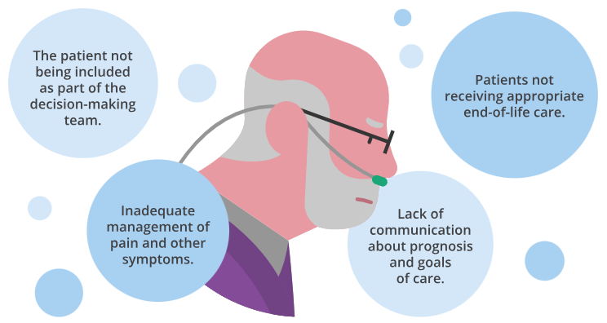
Why do we sometimes need to speak up and advocate for the patient?

Slide 8
Barriers to speaking up
We don’t like to criticise others and especially other disciplines
Hierarchy / authority in healthcare organisations
Autonomy of practice
We don’t want to look ignorant, incompetent, intrusive, or negative.
So, we don’t ask questions, don’t admit mistakes, don’t offer ideas and we don’t critique the status quo.³

Slide 9
Building Psychological Safety³
Is speaking up!
Knowing that conflict / difference of opinion happens
Knowing how to create a climate of openness
Frame mistakes or uncertainties as learning points
Acknowledge we are all fallible: ‘I may have just missed something’
Model curiosity

Slide 10
Building Psychological Safety³
Building psychological safety can take time, but it can be done to create a culture that values:
Framing issues as learning, this creates a reason for speaking up with ideas
Sharing with team members that everyone has made mistakes and using these as a learning or teaching opportunity
Asking questions and creating a culture of curiosity.

Slide 11
Conflict happens
We all want to collaborate, negotiate, have inclusive emotionally aware conversations and discussions.
Conflict is often seen as unwelcome, however well managed, respectful responses to conflict have the potential to strengthen team respect and decision-making.⁴
The following slides discuss a stepwise approach⁵ to navigating conflict.

Slide 12
A stepwise approach⁵
1. Notice the conflict
Ask yourself – are you feeling angry or irritated?
2. Prepare yourself Am I thinking straight? Am I too angry to fully listen?
3. Find a non-judgemental starting point
What would an impartial third person say this conflict is all about?
4. Reframe emotionally charged issues
How can I reframe my thoughts and language so move away from “I’m right”?

Slide 13
A stepwise approach⁵
5. Respond empathetically
Have I responded showing I understand others’ feelings and points of view?
6. Look for solutions that meet the needs of all Does this option address the other person’s and my concerns?
7. If no satisfactory agreement can be reached, get help
Who can you call for back up?

Slide 14
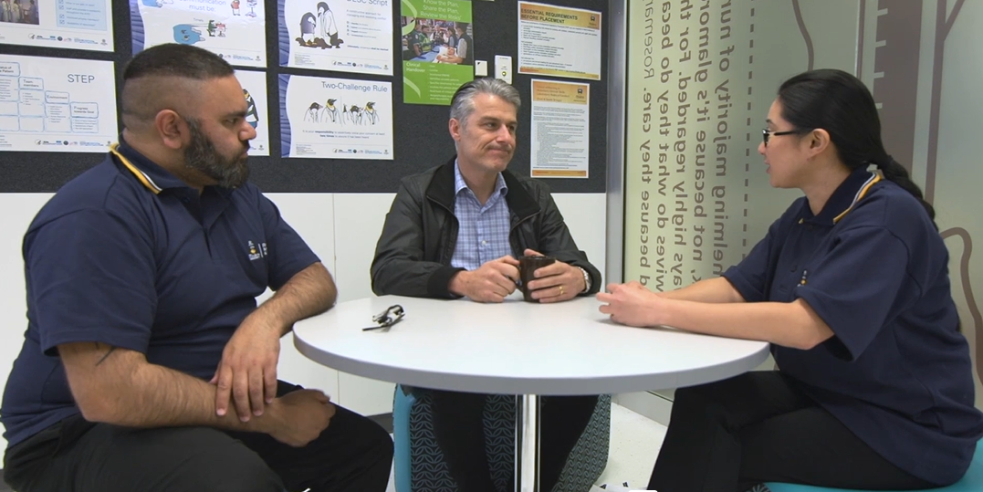
Film – Managing Conflict
CLICK THIS LINK
To watch the film ‘Managing Conflict’ (4 mins and 9 sec)
The scenario in the film demonstrates the complexities around managing the needs of one patient, George, and his relatives. As you watch these interactions, think about the responses shown and consider which ones you could adapt and adopt in your own practice.

Slide 15
Summary
Patients and families are a central part of healthcare teams.
Effective teamwork encompasses leadership, clear goals, clear roles, trust, respect, and a cultural readiness to allow patients to steer care.
Effective end-of-life care requires you to speak up to advocate.
Feeling safe to speak up is a key to effective teams.
Everyone in the team can learn about the best way to approach conflict.
Resources are available to assist you to change your practice.

Slide 16
Which modules should I complete next?
End-of-Life Care for Diverse Communities
Coordinating Patient Care
Voluntary Assisted Dying in Acute Hospitals

Slide 17
References
Australian Commission on Safety and Quality in Health Care (ACSQHC). Implementing the Comprehensive Care Standard: Deliver comprehensive care. September 2020. https://www.safetyandquality.gov.au/sites/default/files/2020-12/implementing_the_comprehensive_care_standard_-_deliver_comprehensive_care.pdf
Clements D, Dault M, Priest A. Effective teamwork in healthcare: research and reality. Healthc Pap. 2006 Dec;7:26-34. https://pubmed.ncbi.nlm.nih.gov/17478997/
Edmondson AC, Higgins M, Singer S, Weiner J. Understanding Psychological Safety in Health Care and Education Organizations: A Comparative Perspective. Res Hum Dev. 2016 Jan 2;13(1):65-83.
Devery K, Winsall M, Rawlings D. Teams and continuity of end-of-life care in hospitals: managing differences of opinion. BMJ Open Quality. 2022;11:e001724. https://bmjopenquality.bmj.com/content/11/2/e001724
Back AL, Arnold RM. Dealing with conflict in caring for the seriously ill: "it was just out of the question". JAMA. 2005;293(11):1374-1381. doi:10.1001/jama.293.11.1374

