Slide 1



Recognising Dying
End-of-Life Essentials (EOLE) is a National Palliative Care Project funded by the Australian Government Department of Health and Aged Care and delivered by Flinders University.

Slide 2
Aims and objectives
After completing this talk, you should be able to:
  Analyse the factors that may influence when end of life begins for a patient
  Begin to identify your own capabilities in identifying end of life
  Identify tools and phrases to use to assist in identifying end of life
  Identify which End-of-Life Essentials module to complete next

Slide 3

Most Australian’s die in hospital.¹
In the year before death, on average, people will be admitted to hospital four times.¹
Within Australian hospitals, recognition of death is predominantly within the last few days of life.²
Think about your death – what would you wish for yourself?

Slide 4
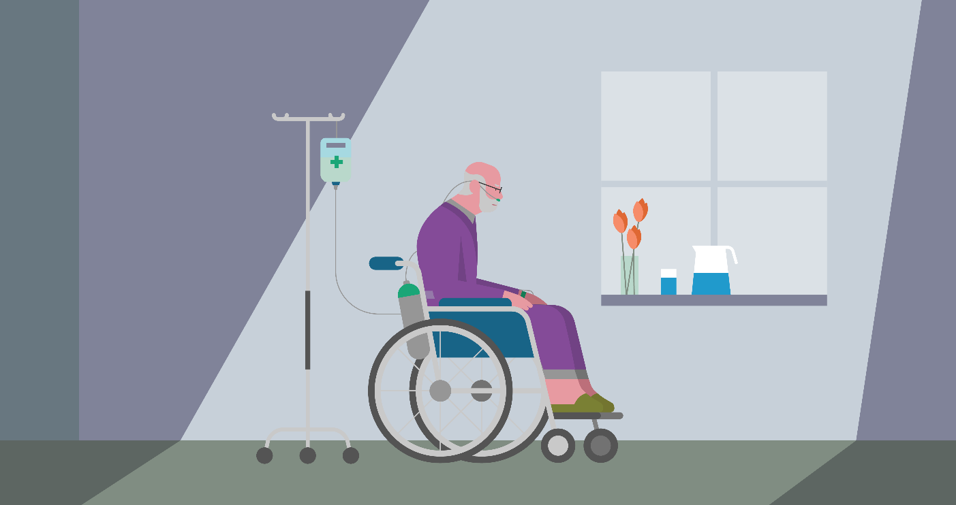
What is end of life?
The period when a patient is living with and impaired by a serious progressive condition, even if the trajectory is uncertain or unknown.
This period may be 12 months or more before death.
Notes:
As healthcare professionals largely focus on improving health and function, they can be unprepared or uncomfortable when thinking about or discussing end of life topics. This can lead to hesitancy in identifying patients at the end of life and in beginning conversations about end of life. Recognising dying several months or weeks before death can be complex and uncertain.

Slide 5
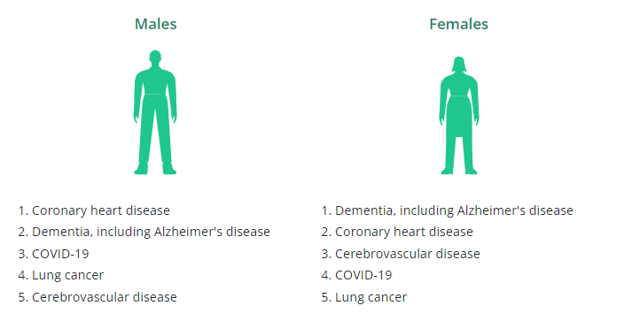
Leading causes of death
The top 5 leading underlying causes of death per sex in Australia³
Notes:
Here we see the top 5 leading causes of death for males and females within Australia during 2022, according to the Australian Bureau of statistics.

Slide 6
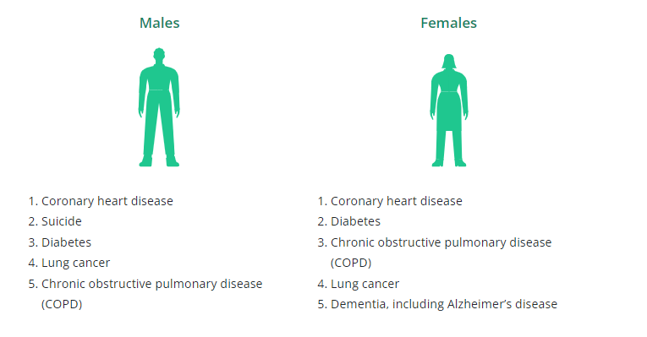
The top 5 leading underlying causes of death per sex for First Nations people³
Notes:
Here we see the top 5 leading causes of death for First Nations males and females within Australia during 2022, according to the Australian Bureau of statistics.

Slide 7
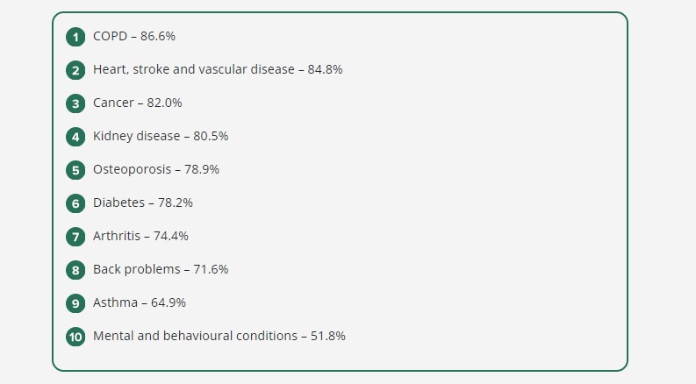
Chronic complex conditions
People with chronic conditions often have more than one condition at once, this is termed comorbidity. Please see below the prevalence of comorbidity varied across chronic conditions.⁴
Notes:
In 2022, chronic conditions were recorded as an underlying or associated cause of death for 90% of all deaths. Chronic conditions become more common with age, with 94% of people over 85 years old with at least one chronic condition.

Slide 8
Trajectories of decline⁵
Sudden death: rapid, unexpected death from causes such as head trauma or drowning.
Terminal illness: conditions such as cancer or motor neurone disease, where there is a period of relative stability until treatment is no longer viable and a person’s health quickly declines.
Organ failure: conditions such as congestive heart failure results in gradual decline with periodic acute aggravations of the underlying condition. Each aggravation is potentially fatal, but prognosis is uncertain.
Frailty: conditions of advanced ageing such as dementia and stroke can be associated with slow but progressive decline. Death may eventually occur from other medical complications such as respiratory illnesses.
Notes:
Patients living with a serious progressive condition may deteriorate in certain patterns or trajectories. Please note, these trajectories are broadly predictive and may not be helpful for individual patient prognostication.

Slide 9



End-of-life conversations
Clinicians don’t like talking about dying. They’re there to be positive, to keep you alive.
To a certain extent, I think they see death as a failure on their part.⁶
Notes:
Death is everyone’s business. It’s not a medical problem, and not a failure of medicine, it is a part of life. It may or may not be a surprise to you that end-of-life care in acute hospitals could be better.
Clinicians report that it is often much easier to continue treatment than to talk with patients and families about the end-of-life. Patients are aware of this.
We know very few patients in Australian hospitals have existing advance care plans.14 It is highly likely that your end-of-life conversation with a patient may be the first-time end-of-life issues have been discussed with them. You may not be able to accurately assess the exact timing of death, but you can look for and recognise signs that end of life is approaching.

Slide 10
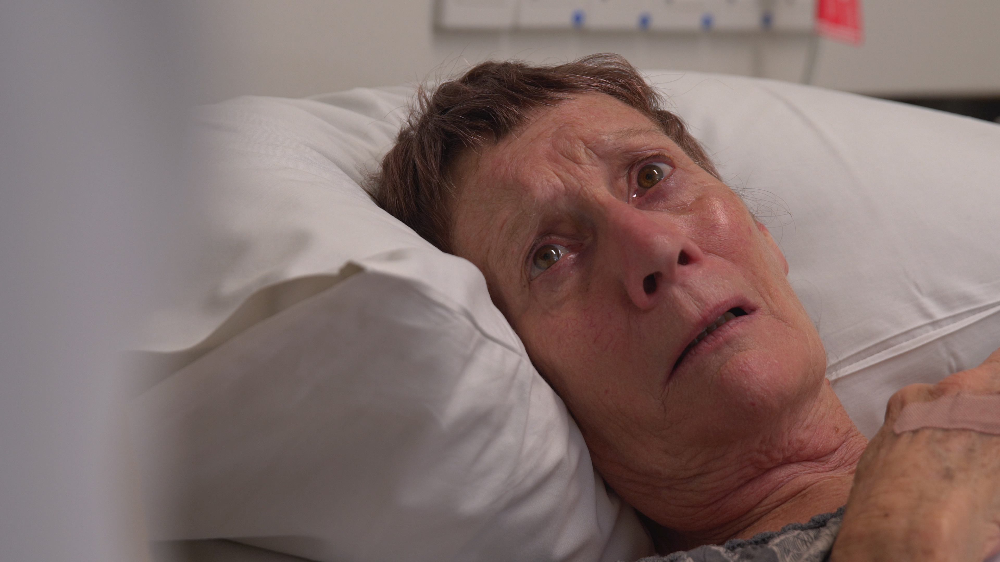
Patient questions
'Am I going to die?'
Notes:
Another trigger to consider is patient questions. such as 'Am I going to die?' Health professionals commonly have a strong focus on fixing and curing ill-health. It can be challenging to step back to reset your approach and respond to a patient like Joan and begin conversations such as ‘I think things are changing for you Joan.’ Explaining illness patterns or trajectories in plain language can be useful in beginning conversations about end of life or responding to patients’ questions about function or the future

Slide 11
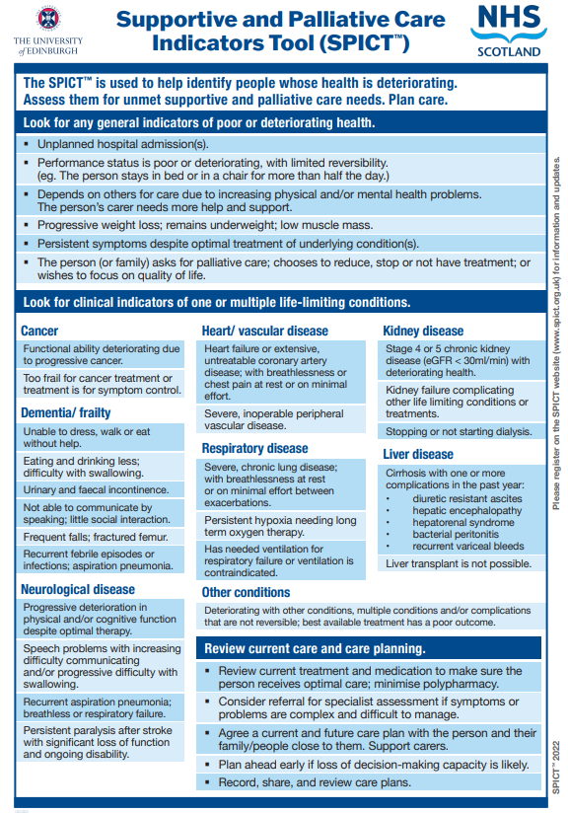
The Supportive and Palliative Care Indicators Tool (SPICT)⁷
End-of-life care needs are identified by the presence of two positive general indicators of deteriorating health, or specific indicators of advancing illness. The general indicators are:
performance status
dependency
unplanned hospital admissions
significant weight loss
persistent troublesome symptom
patient request or treatment withdrawal.
Notes:
SPICT is an example of a tool that can help health professionals to identify if patients have end-of-life care needs. This tool includes a range of indicators including general indicators of declining health and disease-specific indicators of advancing illness. End-of-life care needs are identified by the presence of two positive general indicators of deteriorating health, or specific indicators of advancing illness.
The general indicators are:
performance status
dependency
unplanned hospital admissions
significant weight loss
persistent troublesome symptom
patient request or treatment withdrawal.

Slide 12
Gold Standards Framework⁸
The Surprise Question: ‘Would you be surprised if this patient were to die in the next few months, weeks, days’?
General indicators of decline – deterioration, increasing need or choice for no further active care.
Specific clinical indicators related to certain conditions.
Notes:
The Gold Standards Framework¹⁶ is another available tool, and it details three types of triggers to help you to consider if patients are nearing the end of life.

Slide 13
Summary
Most Australians will predictably die in very old age in a hospital.
Patients and families often are unprepared for health care choices at the end-of-life.
You need to be prepared for unexpected questions about death and dying from patients and or families.
Knowing the common patterns or trajectories of illness can help you identify common trajectories of decline.
Well-coordinated, high-quality end-of-life care begins with early conversations with patients about their wishes, preferences and goals. If these conversations are postponed, patients are unable to express preferences or access high quality end-of-life care.

Slide 14




What module to complete next?
Communication and decision-making
Chronic Complex Illness
Planning EOL Goals of Care

Slide 15
References
Australian Commission on Safety and Quality in Health Care (ACSQHC). Safety and quality of end-of-life care in acute hospitals: a background paper. Sydney; 2013.
Mitchell I, Lacey J, Anstey M, Corbett C, Douglas C, Drummond C, et al. Understanding end-of-life care in Australian hospitals. Vol. 45, Australian Health Review. 2021.
Australian Bureau of Statistics (ABS). Causes of death Australia [Internet]. 2022. Available from: www.abs.gov.au/statistics/health/causes-death/causes-death-australia/latest-release
Australian Institute of Health and Welfare (AIHW), Australian Government. Chronic conditions [Internet]. 2024. Available from: https://www.aihw.gov.au/reports/australias-health/chronic-conditions
Lynn J, Adamson D. Living Well at the End of Life: Adapting Health Care to Serious Chronic Illness in Old Age. Santa Monica (CA): Rand Corporation; 2003.
Australian Commission on Safety and Quality in Health Care (ACSQHC). Safety and quality of end-of-life care in acute hospitals: a background paper. Sydney; 2013.
The University of Edinburgh. Supportive and palliative care indicators tool (SPICT) [Internet]. 2016. Available from: www.spict.org.uk
Thomas K, Stobbart-Rowlands M. Gold standards framework annual meeting. Improving end of life care using gold standards framework. BMJ Support Palliat Care [Internet]. 2011;1(1). Available from: www.goldstandardsframework.org.uk

