Slide 1
How to support yourself and other staff after a patient has died
EOLE is funded by the Australian Government Department of Health and Aged Care

Slide 2
See the accompanying Seminar Notes and References / Resources Documents

Slide 3
Aims and Objectives
You’ll develop an understanding of how to support yourself and others.
After completing this seminar you should be able to:
Analyse the factors that may influence your own wellbeing
Begin to identify your own capabilities in effective selfcare
Identify which End-of-Life Essentials module to complete next

Slide 5
Practice self-care, and understand what works for you
Ask yourself – ‘what does this look like for you’?
What is your work/life balance?
Do you actively practice self-care?
What do you do to relax, unwind or switch off from work?

Slide 6
Practice self-care, and understand what works for you
Film – Understanding Self Care – 3mins 38 secs
https://www.youtube.com/watch?v=NROlDol_6I4&t=213s
Film – Diana’s Story 3 mins 59 secs https://www.youtube.com/watch?v=c6_a7VE2Eoc&t=158s

Slide 7
Talk and debrief with your supervisor or counsellor or friend or trusted colleague
Are you aware of what is available to you in order to debrief?
Are there post-shift debriefs? Do you only debrief following a critical incident? Do you debrief at all as a team?
Find your own source of support within or external to your organisation
Employee Assistance, your manager /supervisor, a colleague, a friend, reflective clinical supervision

Slide 8
Acknowledge each death
Do you have rituals in place to acknowledge each death?
For example:
‘The Pause’ in ICU and ED https://thepause.me/2015/10/01/about-the-medical-pause/
Reading out the name(s) of those who have died at handover
Taking a minute yourself to say goodbye to someone you have cared for (perhaps when certifying death or laying out the body)

Slide 9
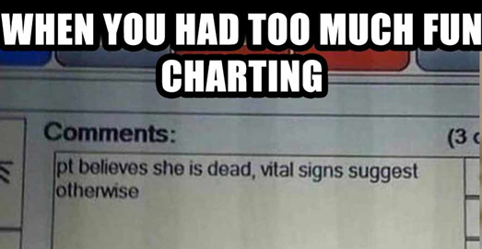
Know it is ok to experience humour and happiness in the face of death
Humour generally can relieve stress and tension, and produce a feeling of wellbeing (a coping mechanism at times)
https://www.psychologytoday.com/au/blog/understanding-grief/201611/the-healing-power-laughter-in-death-and-grief
‘Black humour’
https://anmj.org.au/black-humour-use-it-for-the-purposes-of-good-and-not-evil/

Slide 10
Take time to explore your own reactions and beliefs to end of life and what matters to you
Consider whether your views are impacted by:
Religion / atheism
Culture
Spirituality
Death Anxiety
What you consider a ‘good death’ to look like
MacLeod et al., 2019. Death Anxiety Among New Zealanders: The Predictive Roles of Religion, Spirituality, and Family Connection Omega: Journal of Death and Dying, 80(1), p.3-19.
Rushton C., Edvardsson, D. 2021. A genealogy of what nurses know about ‘the good death’: A socio‐materialist perspective. Nursing philosophy, 22 (4), p.e12365-n/a

Slide 11
If you were not on the ward at the time of death, try and get a sense of their last hours
Consider asking colleagues what it was like for them
Critical incident analysis / audit may shed light on a situation that could have been handled differently
Is it usual practice to follow up families /spouses /significant others’ following a death?

Slide 13
Supporting the team
Who do you consider to be a part of your team?
Does this include staff outside of the immediate health care team (e.g., housekeeping /domestic staff, pastoral care /chaplains)?
Do you know where you can access support in your organisation? Are there resources locally that you can tell colleagues about?

Slide 14
In Summary
Supporting yourself and other staff after a patient has died can be strengthening to your team and yourself.
Acknowledging the deaths of patients and your own compassion can strengthen your clinical practice

Slide 15
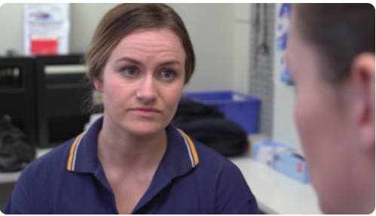
Other EOLE eLearning Topics
Dying, a normal part of life
Patient-Centred Communication and Shared Decision-Making
Recognising the End of Life
Responding to Concerns
Planning End-of-Life Care - Goals of Care
Teams and Continuity for the Patient
ED – EOL Care
Paediatrics – EOL Care
Imminent Death – How to Respond
Chronic Complex Conditions – EOL Care
End-of-Life Care for Diverse Communities
The Importance of Coordinating Patient Care
States of Mind
States of Mind at the End of Life
Assessing Patient States of Mind at the End of Life
Clinical Management of Anxiety, Depression and More
End-of-Life Essentials (endoflifeessentials.com.au)

