Slide 1
Recognising Dying
EOLE is funded by the Australian Government Department of Health and Aged Care

Slide 2
Aims and Objectives
You’ll develop an understanding of the how to recognise the end of life.
After completing this talk you should be able to:
Analyse the factors that may influence when end of life begins for a patient
Begin to identify your own capabilities in identifying end of life
Identify tools and what phrases to use to assist in identifying end of life
Identify which End-of-Life Essentials module to complete next

Slide 3
Around two thirds of Australians die at 75-95 years of age
Estimated 70% of all deaths are expected
Numbers of Australians who die each year will double in the next 25 years²
Think about your death – what would you wish for yourself? The Gratten Report Dying Well 2014
Notes:
We don’t like to think much about the end of life- but it is inevitable. There are fairly stable patterns to how Australian die, as you can see here.

Slide 4
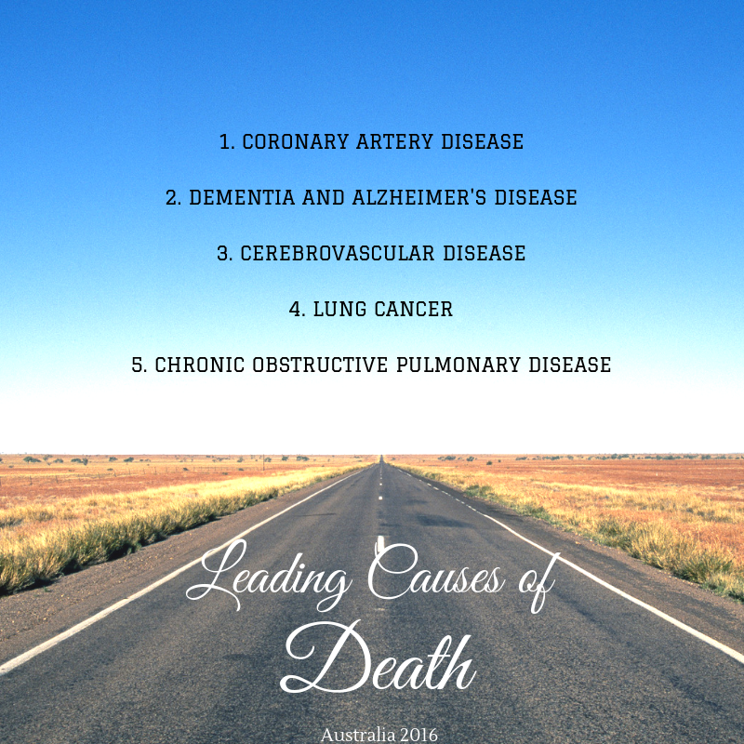
Notes:
These are the leading causes of death in Australia, from the Australian Institute of Health and Welfare, 2019 – reflect on who are the patients admitted to your ward or unit.

Slide 5
Figures from
3. Palliative Care Australia, http://dyingtotalk.org.au/ 2016
4. End-of-life Law in Australia, QUT 2014
Notes:
Now let’s look at how many of us think about talking about or planning for the end of life .
Respondents in 2021 believe that talking about their preferences for the end of their life with their family will upset them (54%) and find the subject of death and planning for the end of their life too difficult to talk about (48%). https://palliativecare.org.au/mediarelease/new-campaign-launches-to-challenge-perceptions-about-palliative-care/

Slide 6
So?
Patients could be poorly prepared for their future (and may not know for example, their chronic complex illness will end their lives). Most patients die an expected death at very old age.
Hospital health care professionals (where 54% Australians die) are excellent at prolonging life but are not so good at recognising end of life or providing EOL care.
Early identification of end of life is recommended by the World Health Organisation as key to providing quality and safe care.

Slide 7
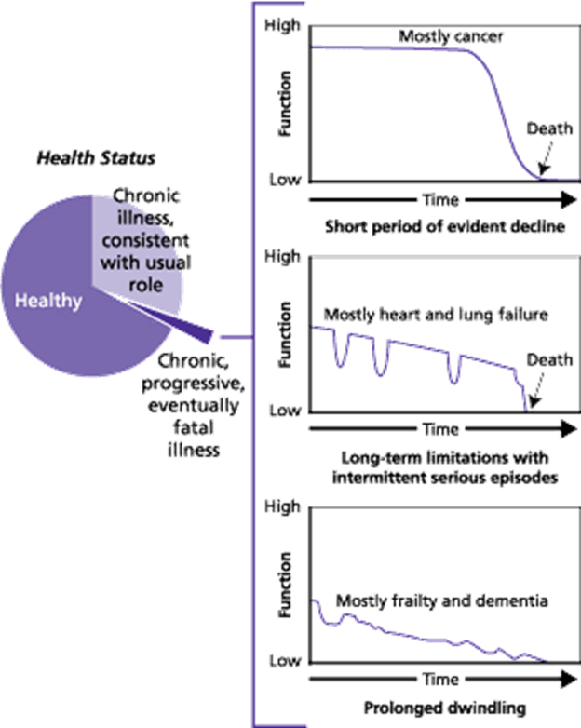
Patterns of end of life – When are we aware of our mortality?
Lynn J, Adamson DM. Living well at the end of life. Adapting health care to serious chronic illness in old age. Santa Monica (CA): Rand Corporation; 2003
Notes:
The first graph shows a ‘typical’ illness trajectory of cancer, with function remaining high until near death. You could argue that a patient who first hears that they have a diagnosis of cancer, signified by the red circle on the graph, has a heightened awareness of their own death.

Slide 8
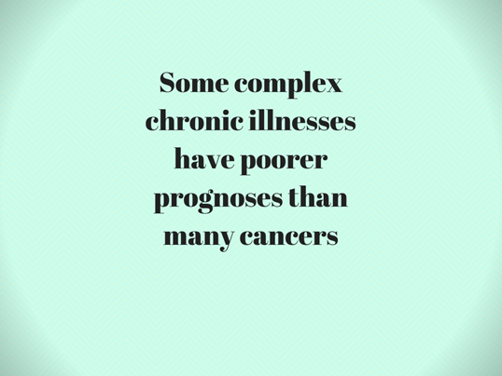
When does end of life begin?
Advanced congestive heart failure with severe symptoms has a one-year mortality of 30-40%. However, the illness has an unpredictable pathway. While some patients recover from acute episodes of deterioration, unpredictably 15-20% of other patients die a sudden death. ⁶
EOLC=1-2 years before death (ACQSHC) allows choice and shared care.

Slide 9
Notes:
Trying to identify end of life does come with uncertainty. Partly because we have become so effective at treating exacerbations of ill-health and prolonging life.

Slide 10
Notes:
The surprise question is one way to prompt you to consider and assess the end of life for your patients. You’ll find more in End-of-Life Essentials Recognising End-of-Life module.
Also
SPICT,
Mayo Clinic Fifth Vital Sign - Nurses’ pattern recognition and sense of worry can provide important information for the detection of acute physiological deterioration
Romero-Brufau S, Gaines K, Nicolas C, Johnson M , Hickman J, Huddleston J,
The fifth vital sign? Nurse worry predicts inpatient deterioration within 24 hours, JAMIA Open

Slide 11
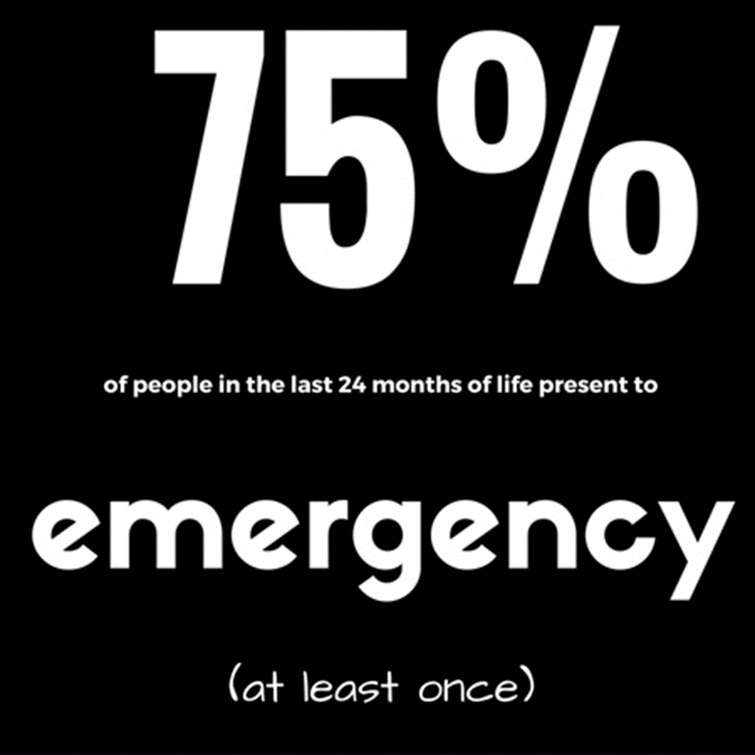
New South Wales Department of Health. Guidelines for end-of life care and decision-making (163KB pdf). Gladesville (NSW): NSW Department of Health; 2005 Mar.

Slide 12
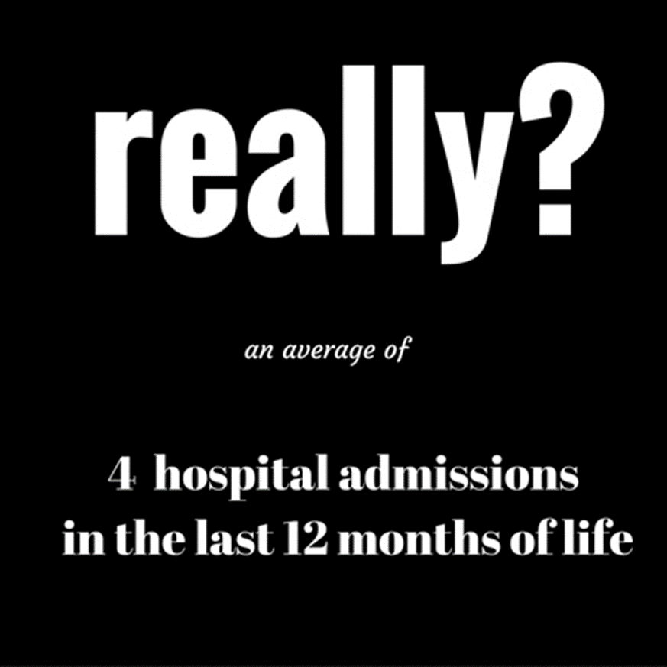
Agency for Clinical Innovation (ACI). Fact of Death Analysis 2011/12 – Use of NSW public hospital services in the last year of life by NSW residents (720KB pdf). Chatswood (NSW) ACI;2015 Sep.

Slide 13
End-of-Life Care
Challenging - health care professionals may be initiating discussions with patients who have never spoken to anyone about their end of life wishes
Limited undergraduate preparation and limited post graduate for end-of-life care in acute care settings⁵

Slide 14
Think about
Do we inform patients? What opportunities are lost?
When do we inform patients and families? Too late to facilitate what matters to the patient?
How do we inform patients and families? Compassionately or ‘there is nothing more we can do’ or ‘would you wish to be resuscitated?’
Notes:
What opportunities are lost? Could be connecting with family, putting affairs in order, what else?
Too late to facilitate what matters to the patient? Are we informing patients during their last admission?

Slide 15
Notes:
Which one would you choose?

Slide 16
Your skill set⁷ in end-of-life care
Expanded tolerance for clinical ambiguity/uncertainty
Prognosis for an individual is inexact
Tolerate strong emotions
Suffering, moral distress, sadness, grief and loss
Accept complexity
Physical, spiritual, emotional and social care needs are often complex

Slide 17
Notes:
What opportunities are lost? Could be connecting with family, putting affairs in order, what else?
Too late to facilitate what matters to the patient? Are we informing patients during their last admission?

Slide 18
What can you do?
Offer to discuss the future
“Some people like to know everything that is going on with them and what may happen in the future, others prefer not to know too many details. What do you prefer?”
Clayton JM, Hancock KM, Butow PN, et al. Clinical practice guidelines for communicating prognosis and end-of-life issues with adults in the advanced stages of a life-limiting illness, and their caregivers. Med J Aust 2007; 286(12): S79-S108

Slide 19
Adapt and Adopt
“I know that often people expect doctors to know what is going to happen, but in truth we can often only take educated guesses and can often be quite wrong about what the future holds, and especially how long it is. What we can be sure about is . . . and what we don’t know for sure is . . .”
“We’ve been talking about some treatments that are really not going to be effective now and that we don’t recommend you use. But there are a lot of other things we can still do to help and support you and make sure you are as comfortable as possible.”
“What are your most important [hopes/expectations] about the future?”
“As you think about the future and that you may not have a very long time to live, what is most important to you? Are there any aspects of your life that you want to attend to?”
“What are the things you most want to invest your time and energy in?” “What are the things you want to do in the time you have?” “Is there any particular event that you are looking forward to?”
Clayton JM, Hancock KM, Butow PN, et al. Clinical practice guidelines for communicating prognosis and end-of-life issues with adults in the advanced stages of a life-limiting illness, and their caregivers. Med J Aust 2007; 286(12): S79-S108. © Copyright 2007 The Medical Journal of Australia – reproduced with permission.
Notes:
Think about what phrases feel ok to you – which ones could you adapt and adopt?

Slide 21
It’s ok to say you don’t know exactly when a patient will die.
I am unsure what will happen next, I hope for the best, however unfortunately we cannot make your heart disease go away.
Focus on the patient and their emotion
Yes, I can see this is a shock. Now that you know the seriousness of your illness tell me what matter most to you?
Make a plan
Here is what we can do to assist you with your preferences and wishes.
Notes:
Think about what phrases feel ok to you – which ones could you adapt and adopt?

Slide 23
In Summary
It’s always a good idea to reflect on your own attitudes and readiness to deliver end-of-life care
Recognising the end of a patient’s life is not always straight forward
There are many ways to increase your own capacity in discussing the uncertainty of the future and focusing on what is important to patients
There are end of life screening tools that can be implemented in your ward or unit.

Slide 24
References
Australian Commission on Safety and Quality in Health Care. (2015) National Consensus Statement: essential elements for safe and high‑quality end-of-life care. Sydney: ACSQHC.
Swerissen, H and Duckett, S., 2014, Dying Well. Grattan Institute
Palliative Care Australia, http://dyingtotalk.org.au/ 2016
White B, et al, (2014) Prevalence and predictors of advance directives in Australia, Internal Medicine Journal, 44 :10.
Croxon L, Deravin L, Anderson J. Dealing with end of life—New graduated nurse experiences. J Clin Nurs. 2018;27:337–344. https://doi.org/10.1111/jocn.13907
Glare P, Sinclair C, Stone P, Clayton J, (2015) Predicting survival in patients with advanced disease, in Oxford Textbook of Palliative Medicine, (Cherny N, Fallon M, Kassa S, Portenoy R, Currow D eds) Oxford University Press.
Chochinov H (2013) Health Care Provider Communication: An empirical model of therapeutic effectiveness. Cancer, May 1;119(9):1706-13. doi: 10.1002/cncr.27949.

Slide 25
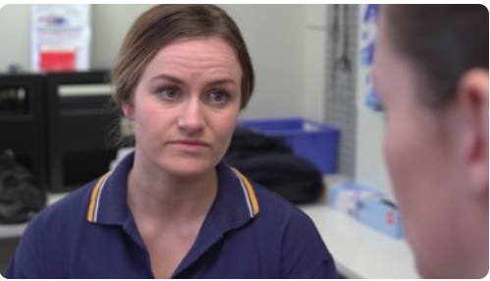
Other EOLE eLearning Topics
Dying, a normal part of life
Patient-Centred Communication and Shared Decision-Making
Recognising the End of Life
Responding to Concerns
Planning End-of-Life Care - Goals of Care
Teams and Continuity for the Patient
ED – EOL Care
Paediatrics – EOL Care
Imminent Death – How to Respond
Chronic Complex Conditions – EOL Care
End-of-Life Care for Diverse Communities
The Importance of Coordinating Patient Care
States of Mind
States of Mind at the End of Life
Assessing Patient States of Mind at the End of Life
Clinical Management of Anxiety, Depression and More
End-of-Life Essentials (endoflifeessentials.com.au)

