Slide 1
Develop communication in the context of: an individual’s response to understanding that life is limited, and discussion of changing goals of care
EOLE is funded by the Australian Government Department of Health and Aged Care

Slide 2
From the Patient Centred Communication and Shared Decision Making Module (See the accompanying Seminar Notes and References / Resources Documents)

Slide 3
Aims and Objectives
You’ll develop an understanding of the importance of communication in end-of-life care.
After completing this talk you should be able to:
Analyse the challenges to your shared decision-making and communication skills
Begin to identify your own capabilities in communicating at the end-of-life
Identify phrases to adapt and adopt
Identify which End-of-Life Essentials module to complete next

Slide 4
Key Points
Key points to remember ¹⁻⁴
Offering to discuss end-of-life issues will not cause harm to your patients.
Anxiety for patients and clinicians is normal when discussing end-of-life issues.
You can make a huge difference by giving patients and their families the chance to talk and prepare for the end of life.
Fried TR, Bradley EH, O’Leary J. Prognosis communication in serious illness: perceptions of older patients, caregivers, and clinicians. J Am Geriatr Soc. 2003 Oct;51(10):1398-403.
Wright AA, Zhang B, Ray A, Mack JW, Trice E, Balboni T, et al. Associations between end-of-life discussions, patient mental health, medical care near death, and caregiver bereavement adjustment. JAMA. 2008 Oct 8;300(14):1665-73.
Block SD. Perspectives on care at the close of life: psychological considerations, growth, and transcendence at the end of life: the art of the possible. JAMA. 2001 Jun 13;285(22):2898-905.
Steinhauser KE, Christakis NA, Clipp EC, McNeilly M, McIntyre L, Tulsky JA. Factors considered important at the end of life by patients, family, physicians, and other care providers. JAMA. 2000 Nov 15; 284(19):2476-82.

Slide 5
Shared Decision Making, Patient Centred Care and Communication
The following concepts define patient-centred care:
Informing and involving patients and those important to them
Eliciting and respecting patient preferences
Engaging patients in the care process
Treating patients with dignity
Designing care processes to suit patient needs, not providers
Ready access to health information
Continuity of care.⁶
Robb G, Seddon M. Quality improvement in New Zealand healthcare. Part 6: keeping the patient front and centre to improve healthcare quality. N Z Med J. 2006 Sep 22;119(1242):U2174.

Slide 6
Shared Decision Making, Patient Centred Care and Communication
No matter what your role, no matter where you work, you can sharpen your skills to ensure that you are making a difference to a patient at the end of his or her life.
We all are constantly learning more on our communication.

Slide 8
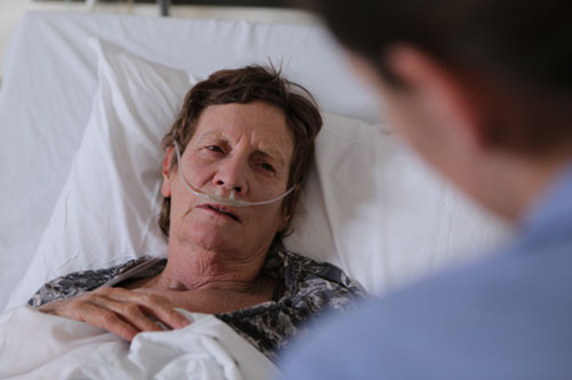
Film
Film - I thought I was going to die (3mins 44 sec)

Slide 9
Barriers
Spend a few moments now and consider how you would respond to the patient in the film.
Be honest.
How would you respond?
If you feel comfortable, share and discuss in your group.

Slide 10
End-of-Life Care
Challenging - health care professionals may be initiating discussions with patients who have never spoken to anyone about their end-of-life wishes.
Limited undergraduate preparation and limited post graduate for end-of-life care in acute care settings⁵

Slide 11
Facilitators
Knowing that death is a normal part of life
Knowing that for many patients talking about dying allows them self-determination and informed decision-making
Knowing your own communication strengths and limitations
Consciously growing your communication skill-set

Slide 12
Skill Set ⁷
Expanded tolerance for clinical ambiguity/uncertainty
Prognosis for an individual is inexact
Tolerate strong emotions
Suffering, moral distress, grief and loss
Accept complexity
Physical, spiritual, emotional and social care needs

Slide 14
How do you know when to discuss EOLC?
The patient may directly ask you.
You may have updates from consultants and your team.
You’ve discussed with the team.
You’ve used a tool like the SPICT.

Slide 15
What can you do?
Offer to discuss the future
“Some people like to know everything that is going on with them and what may happen in the future, others prefer not to know too many details. What do you prefer?”
Clayton JM, Hancock KM, Butow PN, et al. Clinical practice guidelines for communicating prognosis and end-of-life issues with adults in the advanced stages of a life-limiting illness, and their caregivers. Med J Aust 2007; 286(12): S79-S108

Slide 16
Adapt and Adopt
“What are your most important [hopes/expectations] about the future?”
“As you think about the future and that you may not have a very long time to live, what is most important to you? Are there any aspects of your life that you want to attend to?”
“What are the things you most want to invest your time and energy in?” “What are the things you want to do in the time you have?” “Is there any particular event that you are looking forward to?”
Clayton JM, Hancock KM, Butow PN, et al. Clinical practice guidelines for communicating prognosis and end-of-life issues with adults in the advanced stages of a life-limiting illness, and their caregivers. Med J Aust 2007; 286(12): S79-S108. © Copyright 2007 The Medical Journal of Australia – reproduced with permission.

Slide 17
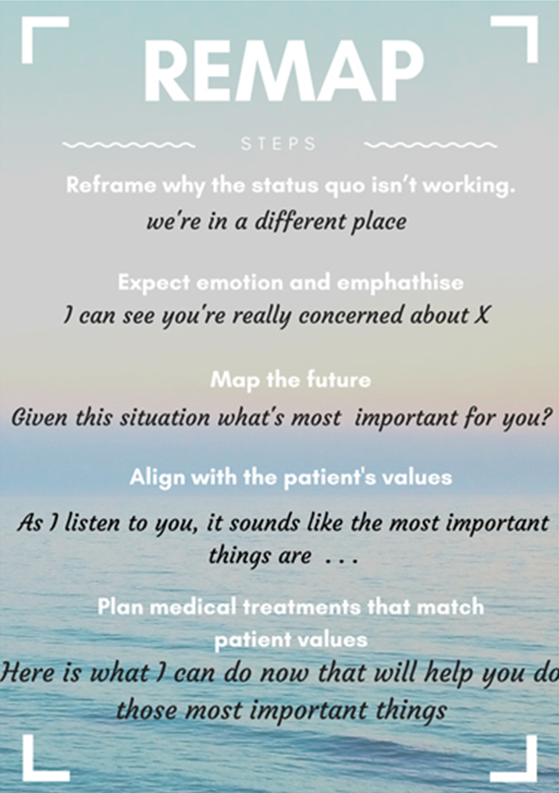
Adopted from VITAL talk REMAP

Slide 19
Common psycho-existential responses to end of life
Most Australians die an expected death after a normal course of chronic complex illness, around the age of 75 years.
Frailty
Loneliness
Multiple losses
Very individual
Fear, grief, guilt, hope, denial,
Anger and sadness
However, many clinicians will report that most people approach the end of their lives the same way they have lived; thus, not everyone is overcome with and focussed on negative emotions. There are ebbs and flows to the sadness and the joys of life when people approach death.

Slide 21
What is one aspect of your communication that you will develop further?

Slide 23
In Summary
You can make a huge difference by giving patients and families the chance to talk and prepare for the end of life.
You can prepare for unexpected but common questions from patients and families. What will happen to me? Is this the end?
Resources are available for you to extend your practice by adapting and adopting end-of-life care skills.
Self-care is highly recommended for all health professionals.

Slide 24
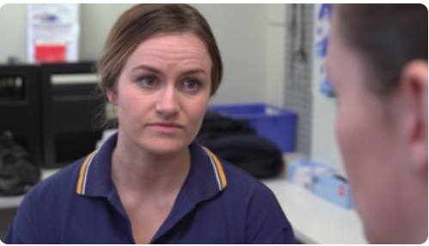
Other EOLE eLearning Topics
Dying, a normal part of life
Patient-Centred Communication and Shared Decision-Making
Recognising the End of Life
Responding to Concerns
Planning End-of-Life Care - Goals of Care
Teams and Continuity for the Patient
ED – EOL Care
Paediatrics – EOL Care
Imminent Death – How to Respond
Chronic Complex Conditions – EOL Care
End-of-Life Care for Diverse Communities
The Importance of Coordinating Patient Care
States of Mind
States of Mind at the End of Life
Assessing Patient States of Mind at the End of Life
Clinical Management of Anxiety, Depression and More
End-of-Life Essentials (endoflifeessentials.com.au)

