Slide 1
Imminent Death-
How to Recognise it
End-of-Life Essentials (EOLE) is a National Palliative Care Project funded by the Australian Government Department of Health and Aged Care and delivered by Flinders University.

Slide 2
Aims and objectives
After completing this talk, you should be able to:
Identify the opportunities for skilled, compassionate clinical care during the final days and hours of life
Identify the signs of impending death
Recognise reversible causes of decline
Recognise the five steps to deprescribing
Identify which End-of-Life Essentials module to complete next.

Slide 3
The term imminent death means that a person is experiencing irreversible decline in health and that they are likely to die within hours, days or weeks. ¹
Notes:
The imminent death period differs from end of life. The end-of-life period is harder to define, often 12 months or more before death.

Slide 4
Signs of imminent death
CLICK THIS LINK
To watch the video by Melissa Bruno, Nurse Consultant at Northern Adelaide Local Health Network, and Lecturer (Clinical Teaching Specialist) College of Nursing and Health Sciences, Flinders University, talking through some signs and symptoms of imminent death ( 4 mins, 7 seconds).
Notes:
Recognising when a patient is approaching their last weeks, days or hours of death can be a complex task. There are a range of signs and symptoms that commonly herald the last 48 hours preceding death.

Slide 5
Signs of imminent death
Sign | What does it look like?
Profound tiredness and weakness² | Reduced interest in getting out of bed. Needing assistance with all care. Less interest in things happening around them.
Diminished food and fluid intake² | Decrease in appetite and thirst is a normal progression of the body slowing down.
Drowsy or reduced cognition² | Difficulty in concentration. Confusion with time and place. Inability to communicate.
Changes to breathing³ | Slow or irregular breathing. Periods of rapid, shallow breathing “Cheyne-Stokes breathing” is a term used to describe when a patient is having periods of apnoea followed by rapid respirations.
Changes to colour of the skin⁴ | Skin becomes pale and cool to touch due to peripheral vascular shutdown- this is when the body’s circulation slows down, blood is reserved for helping major internal organ function.
Terminal restlessness³ | Agitation Confusion Delirium Emotional distress

Slide 6
Terminal restlessness
Terminal restlessness is the term for a spectrum of unsettled behaviours and symptoms that can happen at the end of a person’s life.⁵
Agitation, confusion, delirium and emotional distress are common symptoms.⁵
Notes:
What causes terminal restlessness?
The process of dying causes physical changes to the body and is often mentally and emotionally overwhelming. Terminal restlessness can be caused by several things associated with dying, including:
Spiritual and emotional distress: Many people fear dying, it is common for patients to experience grief, stress, fear, and other strong emotions.
Pain: Severe pain that isn’t well controlled can cause terminal restlessness.
Opioids: Patients experiencing pain at the end of life are often prescribed an opioid medication. Opioids effect the central nervous system by altering neurotransmitter release and neuronal activity. In some cases this alternation can lead to neuropsychiatric outcomes, including cognitive impairment and delirium.
Organ failure: Basic bodily functions can be disrupted by organ failure, causing a change in the brain chemistry which may lead to terminal restlessness or delirium.
Chemotherapy: Chemotherapy may cause confusion due to metabolic changes or damage to nerve cells.
Medical complications: Complications such as infections, fevers and dehydration at the end of life weaken the patient’s body and impair brain function.
Urinary retention and constipation: Constipation and urinary retention can be caused by weakening of the muscles at end of life, may lead to pain, agitation and cause terminal restlessness.

Slide 7
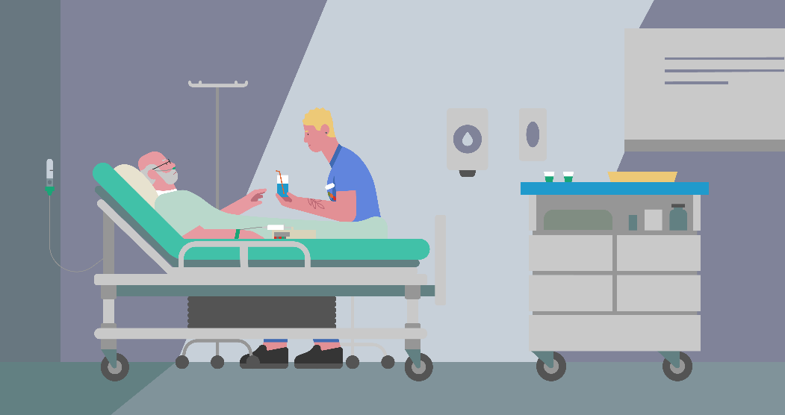
Reversible causes of decline
Some conditions may produce similar signs of imminent death but may be treated. Be aware of reversible causes of decline, which may include:⁶
hypercalcaemia (high level of calcium in the blood)
renal (kidney) failure
infection
side effects of medicines such as strong opioids.
Notes:
When determining whether a patient is imminent dying, always consider ruling out reversible causes of deterioration.

Slide 8
Goals of care and patient wishes
Understand the progress of the individual patient’s illness, the goals of care, the patient and family’s wishes.
The benefits and burdens of investigations or potential treatments.
Remember, just because a blood test or investigation can be ordered, does not mean it should be ordered.
A team and family approach to confirm goals of care should steer care and services at the end of life.⁷
Notes:
It is always important to understand the progress of the individual patient’s illness, the goals of care, the patient and family’s wishes and the benefits and burdens of investigations or potential treatments. Remember, that just because a blood test or investigation can be ordered, does not mean it should be ordered. A team and family approach to confirm goals of care should steer care and services at the end of life.

Slide 9
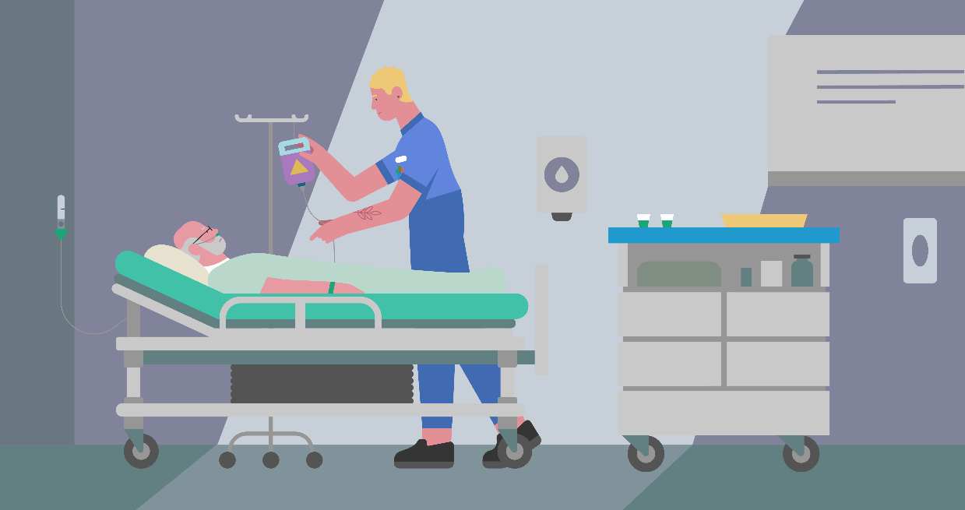
Symptom control
Ensure that medications for common symptoms such as breathlessness, pain, nausea, and constipation are prescribed for PRN use (as needed).
There are several common symptoms that may cause distress in dying patients.
Ordering medications ahead of time, ‘anticipatory prescribing’, is required so that prompt management of these symptoms can occur.⁸
Notes:
Symptom control for patients and end of life may include pharmacological and non-pharmacological approaches, continual assessment, review of interventions, referral to appropriate service providers, involvement of patient and family in decision making and accurate documentation.
Judicious consideration of the benefits and burdens of treatments and interventions is vital. While medical treatments and end-of-life care are not mutually exclusive, a family and team collaborative decision-making approach following agreed goals of care is best for any patient.

Slide 10
Medication management
Five steps to deprescribing⁹
Take detailed medication history including indication for each drug.
Consider potential for drug induced harm i.e. age of patient, comorbidities, number of medications, types of medications.
Consider each individual medication and the potential to provide ongoing benefit.
Prioritise medications for deprescribing (usually one at a time), give explanations to the patient. Agree on follow-up arrangements.
Carry out follow-up assessment to assess effects of deprescribing. Consider further deprescribing.
Deprescribing is not withdrawal of care.
Notes:
Multiple medications may be prescribed to patients near the end of life, many of these medications are used to address chronic conditions and not address symptom alleviation. To improve prescribing practices near the end of life, it is important for providers to diligently reconcile medications with patients and identify unnecessary medications.
Remember, deprescribe and critically review all medication.
Deprescribing is not withdrawal of care.

Slide 11
Responding to a patient in your care imminently dying
Knowing that someone is dying on an acute ward on your shift can be confronting, especially if your training and practice has focussed mainly on ensuring patients live. Knowing how to respond is the key and this knowledge can help you feel more at ease when you are delivering care.
Watch the video below of an example of imminent patient death in an acute hospital.
CLICK THIS LINK
Notes:
Melissa Bruno, Nurse Consultant at Northern Adelaide Local Health Network, and Lecturer (Clinical Teaching Specialist) College of Nursing and Health Sciences, Flinders University, talks through an example of imminent patient death in an acute hospital.
( 1 mins, 38 seconds).

Slide 12
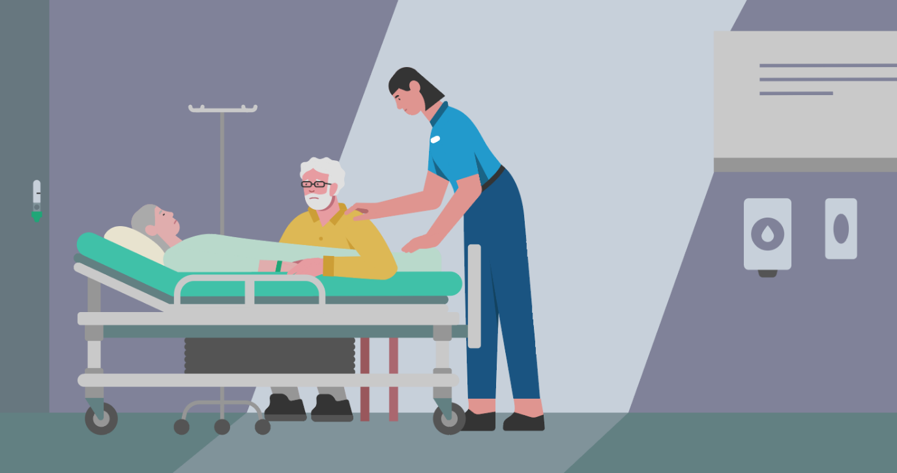
Confirming death for the patient’s family
What can you say to the family when they ask you 'Has mum died?’ Think about how you could respond with compassion
Notes:
This may seem straightforward, however, what if it is outside your scope of practice to certify death? It is unhelpful to say 'I’ll just call the doctor to ask her to come and ascertain if she has died.' So how can you respond?
Here are some examples.
'Can I sit here with you for a moment, sometimes at this time, breathing can be so slow, let’s just see.'
'It looks like she has died, I am so sorry for your loss.'
'I will call the doctor as they will need to see her. How are you? Can I get you a cup of tea? Can I call someone to be here with you?'

Slide 13
Summary
Signs of impending death can be useful to know in terms of providing more information to families and planning your clinical response.
Be aware of reversible causes of decline.
Anticipatory prescribing can be used to prevent or reduce common distressing symptoms.
Deprescribing is not withdrawal of care.
Compassionate communication during the final days of life and once the patient has died can make a huge difference to all involved.

Slide 14
What module to complete next?
Communication and Decision-Making
Recognising Dying
Planning EOL Goals of Care

Slide 15
References
CareSearch. The dying patient. 2023.
Watson M, Campbell R, Vallath N, Ward S, Wells J. Oxford Handbook of Palliative Care: The Essential, Holistic Guide to Palliative Care. Oxford Medical Publicatios. 2019;15(5).
Ijaopo EO, Zaw KM, Ijaopo RO, Khawand-Azoulai M. A Review of Clinical Signs and Symptoms of Imminent End-of-Life in Individuals With Advanced Illness. Vol. 9, Gerontology and Geriatric Medicine. 2023.
Hui D, dos Santos R, Chisholm G, Bansal S, Silva TB, Kilgore K, et al. Clinical Signs of Impending Death in Cancer Patients. Oncologist [Internet]. 2014 Jun 1;19(6):681–7. Available from: https://doi.org/10.1634/theoncologist.2013-0457
White C, McCann MA, Jackson N. First Do No Harm… Terminal Restlessness or Drug-Induced Delirium. J Palliat Med [Internet]. 2007 Apr 1;10(2):345–51. Available from: https://doi.org/10.1089/jpm.2006.0112
National Clinical Guideline Centre (NICE). Care of Dying Adults in the Last Days of Life. London; 2015 Dec.
Montori VM, Ruissen MM, Hargraves IG, Brito JP, Kunneman M. Shared decision-making as a method of care. BMJ Evid Based Med [Internet]. 2023 Aug 1;28(4):213. Available from: http://ebm.bmj.com/content/28/4/213.abstract
Cadogan CA, Murphy M, Boland M, Bennett K, McLean S, Hughes C. Prescribing practices, patterns, and potential harms in patients receiving palliative care: A systematic scoping review. Exploratory Research in Clinical and Social Pharmacy [Internet]. 2021;3:100050. Available from: https://www.sciencedirect.com/science/article/pii/S2667276621000500
Thompson J. Deprescribing in palliative care. Clinical Medicine, Journal of the Royal College of Physicians of London. 2019;19(4).

